Slide 1
Interview and Use Cases
By: Briana, Haythem, Timnit, Daniel, Anusha, James

Slide 2
Interview Overview
Interviewers: Haythem, Briana, James
Ira Fabri Assistant Director of Tutoring 03/15/2019 at 2:30pm
Cassie Hoddinott LRC Director 3/16/19 at 3:30pm

Slide 3
Observation
Ira is responsible of scheduling weekly appointment, contacting StudyTree support whenever it’s needed, and coordinate between tutors and students when schedules do not match.
Tutors should be able to make changes to their own schedules.
Schedules were not accurate in the administrator’s schedule.
Some sessions were scheduled for 9:00 am, tutoring center opens at 10:00am.
No shows were not accurately flagged with a warning or a count.

Slide 4

Observation
Weekly and monthly reports are crucial for the LRC to receive support from administration.
Classroom location edits by administrators.
Students can create a profile to help tutors prepare for their sessions.
Direct messaging is needed between support and tutors.

Slide 5
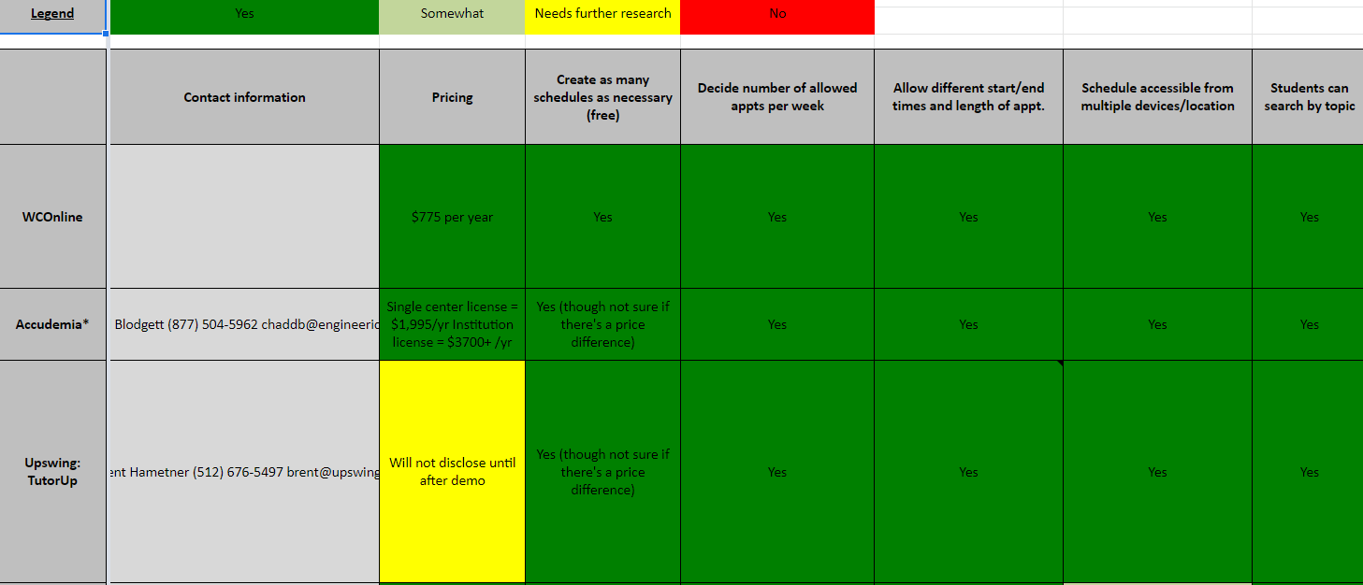
Document Analysis
Note: dONT FORGET TO SCREEN SHOT (From Supervisor: Scheduling system specs AND
(ASAC Scheduling Platform Comparison) for show purposes

Slide 6
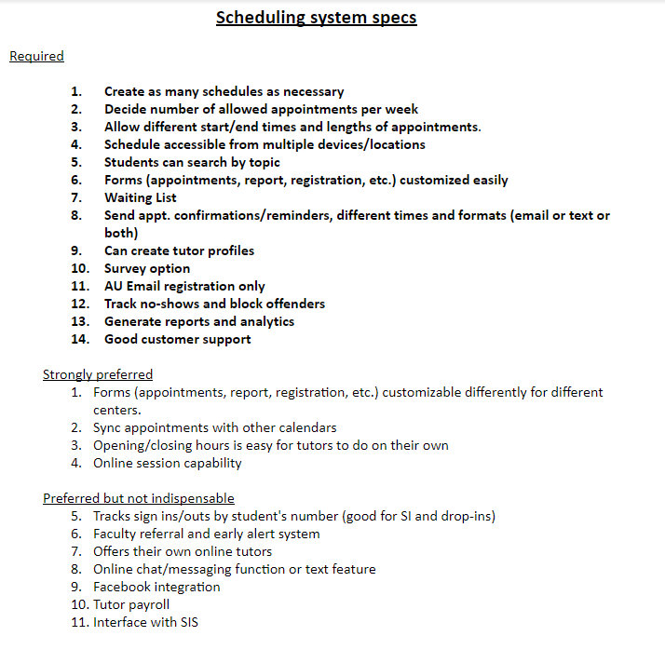

Slide 7
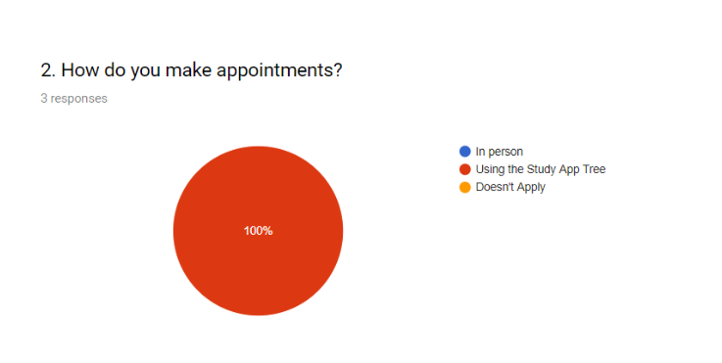
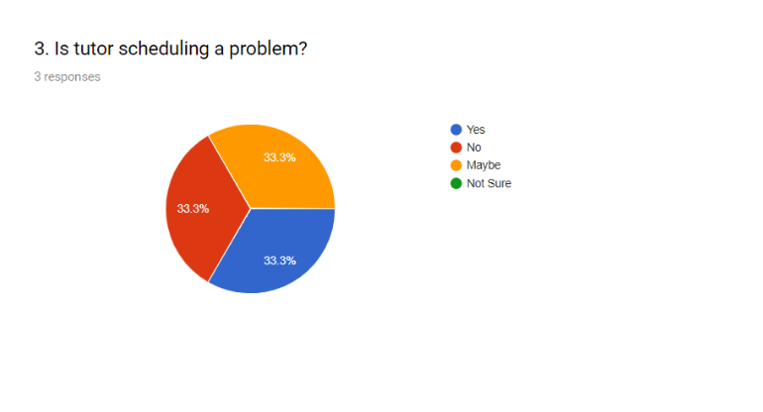
Questionnaire
The Google Form was sent out to 16 staff and students, only 3 responded.

Slide 8
Requirements - Functional
Functional
Process-Oriented:
Schedule Updating
1.1 The app would let the tutors go in and change their schedule around
1.2 Tutors can see how many they are allowed to tutor weekly.
1.3 The app will allow tutors choose which hours they want to be “Available for booking” and which hours to be “Potential hours”
Appointments
2.1 The app will let the student the number of allowed appointment per week and per semester.
2.2 The app will send appt. Confirmation and reminders which can be text or email
Information-Oriented:
. Reports
3.1 The app will have reports for daily, weekly, monthly and yearly activity.
ule Updating
1.1 The app would let the tutors go in and change their schedule around
1.2 Tutors can see how many they are allowed to tutor weekly.
1.3 The app will allow tutors choose which hours they want to be “Available for booking” and which hours to be “Potential hours”
Appointments
2.1 The app will let the student the number of allowed appointment per week and per semester.
2.2 The app will send appt. Confirmation and reminders which can be text or email

Slide 9
Requirements - Non-functional
Non-functional
Operational:
1.1 The app will allow different start/end times and length of appointments
1.2 The app will generate reports and analytics
Performance:
1.1 The app will have great customer support
Security:
1.1 The app will track no-shows and block offenders after 2 consecutive No-shows
Cultural and political:
1.1 The app will have a survey option for students to take for feedback at the end of every semester.
Notes:
Briana

Slide 10
High:Use Case #1: Registration
Brief Description: This use case will have umbc email registration only, and will help create the tutor, student and supervisors profiles. It will also, able the students to be able to be waitlisted for booked sessions so they don’t have to keep checking the app for booked session to open up. Supervisors will be able to keep tract/ interact with students and tutors.
Actor: Students, Tutors and Supervisors
Trigger: Students can use the app to book a session with a Tutor and a Tutor can register in order to be matched up with a student.
Type: External
Preconditions:
Student, tutor and supervisor must have a functioning umbc email
Tutors must be hired by the UMBC supervisor
Students, tutors, and supervisors must remember their login information
Supervisors must be authorized by UMBC to monitor tutors and students
Normal Course
Students and Tutors register with their UMBC email
A registration confirmation is sent to their email
Students/tutors can login with their email and password to on the app
Postconditions:
When waitlisted student is able to register for a session a reminder is sent via email.
Students should remember they login information for future login purposes
A classroom where a student and a tutor can meet is set
Output: Registration is complete and students can have a waitlisted appointment sessions
Notes:
Timnit

Slide 11
Use Case #2: Forms
Brief Description: This use case describes how the app will have forms that can be customized to the students/tutors/supervisors needs. This can be used by students and tutors to customize their own appointments as well as the subjects they are interested in. The supervisor will also, be able to customize reports
Actor: students, tutors and supervisors
Trigger: The need of customizing of personal preference in regards tp appt and courses and reports
Type: External
Preconditions:
Students, tutors, and supervisors must have be registered users of the app.
There must have students and tutors that are actively engaged in order for a supervisor to be able to customize reports.
Normal Course:
Students and tutors can customize their schedules and courses before booking any sessions.
Supervisors can customize reports before generating them.
Postconditions: Report has been generated.
Output: Customized schedule and courses for students and tutors, Customized report .
Notes:
Timnit

Slide 12
Use Case #3: Updating Schedules
Brief Description: This use case describes how the app will allow autonomy for tutors in regards to changing their schedule, the amount of hours they would like, and the number of students they will see per week.
Actor: Tutors
Trigger: Tutors preparation for their work week. This incorporates changes in schedule, and in hours to work.
Preconditions:
The tutor must have an emergency change in schedule.
The tutor must know how many hours they would like to register for.
Normal Course
Tutors are able to access their schedule
Tutors can change their schedule
If they would like more hours, it can be checked in the database.
If they would like to release some tutoring session, student will receive a notice of a schedule change.
Changes in schedule will be recorded in the system.
Postconditions:
Tutor has a revised schedule
Notice is sent to student of revision if it pertains to the student.
Output: Revised schedule with notices being sent to students regarding the change
Notes:
Daniel

Slide 13
Use Case #4: Appointment
Brief Description: This use case will describe how and how many tutoring appointments can the students make per week with its confirmation as well as reminder via text or email.
Actor: Students
Trigger: Helping students book an appointment on time and remind them about the appointments.
Type: External
Preconditions:
Student will need to login with their student id and password.
The students should know the limitation of appointment.
Student should select the means of reminder i.e. text or email.
Normal Course
Students can book the available appointments.
The appointment is received and acknowledged.
Appointments will be recorded in the system.
Confirmation and reminder of the booked appointment is sen
Students can book for waitlisted appointment
Postconditions:
Students know the limitation of appointment and schedule on time and only when needed.
Confirmation is sent after booking an appointment.
Reminder is sent via text/email before the appointment time.
Output: Necessary appointments made and a confirmation and reminder sent to the students.
Notes:
Anusha

Slide 14
Use Case #5: Reports
Priority: High
Brief Description: This use case describes how the app will have forms that can be customized to the students/tutors/supervisors needs. This can be used by students and tutors to customize their own appointments as well as the subjects they are interested in. The supervisor will also, be able to generate reports that are need for evaluating the tutoring program.
Actor: Supervisor, and App Database
Trigger: It is the end of a day, week, month and year
Type: temporal
Preconditions:
App can track activities done by students and tutors
Supervisor can customize reports
Normal Course
Daily, weekly, monthly and yearly reports are generated
Postconditions:
Reports have been generated based on the supervisors need
Output: Reports are given by the app based on daily, weekly, monthly, and yearly basis
Notes:
Timnit

Slide 15
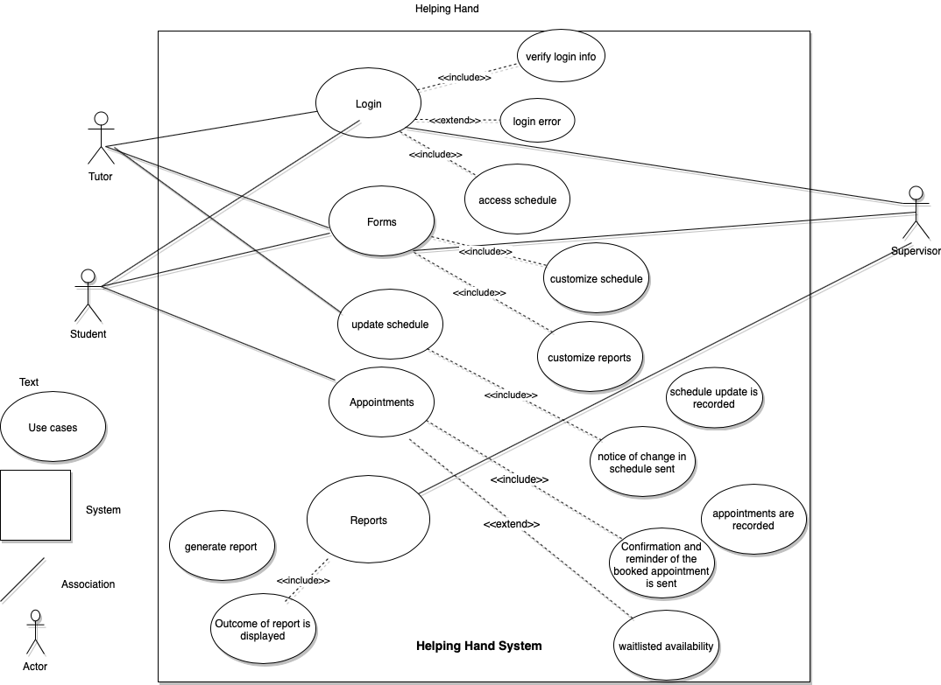

Slide 16
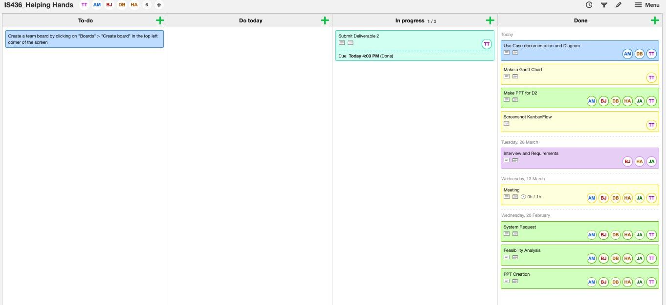
KanbanFlow

Slide 17


Slide 18


